Slide 1
ISO/TC211/AG 5
Harmonized model maintenance group (HMMG)
56th Plenary Meeting Week Hybrid, New Delhi & Zoom – December 6th 2023
Knut Jetlund, Convenor

Slide 2
ISO Code of Ethics and Conduct

Slide 3

What and why?
The ISO Code of Ethics and Conduct was adopted by the ISO Council in February 2023, replacing the earliy Code of Conduct.
It set out principles for the conduct of persons acting on or behalf of ISO, including the ISO standards development community - us.
The goal is that our deliverables benefit the international community over and above the interests of any individual or
organization.
ISO Code of Ethics and Conduct

Slide 4

All ISO actors must uphold and respect the Code of Conduct
ISO Central Secretariat (ISO/CS)
National standards bodies (NSBs)
Individuals representing those member bodies
ISO committee chairs, committee managers, working group (or any established consensus group under a committee) convenors, WG secretaries, project leaders
Delegates and experts, including liaisons

Slide 5
Principles
Comply with legal and statutory obligations
Perform and act in good faith, consistent with the purpose, policies and principles of the organization
Behave ethically
Promote and enable all voices to be heard
Engage constructively in ISO activities
Declare actual and potential conflicts of interest and manage them appropriately
Protect confidential information
Protect ISO assets
Avoid and prevent any form of bribery or corruption
Escalate and resolve disputes and uphold agreed resolution
Notes:
Same as before: 3
Slightly extended: 10
Reworded: 5
The others were all in the directives?

Slide 6
Agenda
 | Agenda item | Chair
1 | Welcome and introduction | HMMG Convenor
2 | Roll call | All
3 | Status for the Harmonized Model and the Programme of work (https://committee.iso.org/sites/tc211/home/projects/projects---graphic-overview.html) | HMMG Convenor
4 | Project Teams’ work with the Harmonized Model | HMMG Convenor
5 | HMMG work and model maintenance | HMMG Convenor
6a | Other issues: collaborations with OGC and Sparx, Overture Maps | HMMG Convenor
6b | Issues from project meetings | All
7 | Liaison activity | HMMG Convenor
8 | HMMG Recommendations and report to the plenary | HMMG Convenor
9 | Any other business | All
10 | Close | All

Slide 7
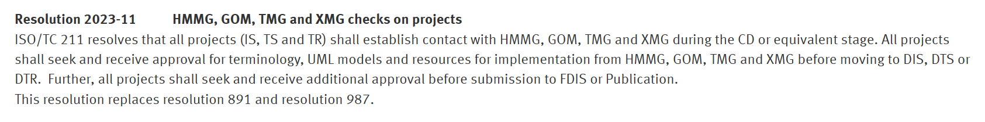

Status for the HM and POW
UML models shall be in the HM before CD/DTS ballot
UML models shall be controlled between the CD and DIS stages
Documents shall not pass ballot until the review is completed
Because…
Derivation of resources for implementation - XSD, OWL
Reuse in other standards and by other stakeholders
Reuse in future revisions
Automated documentation

Slide 8
Status for the HM and POW
The cooperation with PTs and WGs is still very good ☺
Projects are working in different ways
Depending on technical restrictions and possibilities set by governments and employers.
More interactive work:
Virtual PT and WG Meetings, GitHub and ISO Documents, Email discussions, Cloud sharing…
Easier to follow and controll the UML work
HMMG members can attend more PT and WG meetings.
Can participate in discussions on GitHub

Slide 9


Tools for UML modelling
EA is mandatory for all UML work!
Use a recent version (EA 15 or 16)
https://github.com/ISO-TC211/UML-Best-Practices

Slide 10
Enterprise Architect Licenses
Sparx Systems provides free licenses for development and maintenance of the Harmonised Model
Experts, Project leaders, Editors, Convenors…
Requests are handled through the ISO/TC 211 Secretariat

Slide 11
Tools for UML modelling
EA version 16 64 bit released last year https://sparxsystems.com/products/ea/16.0/index.html
Good: New file format .qea – based on SQLite
Challenge: Cannot read .eap
Can read .eapx if 64 bit Jet DB Driver
.eap and .eapx can be upgraded to .qea with wizard
GitHub resources will be both .eap and .qea until further notice

Slide 12
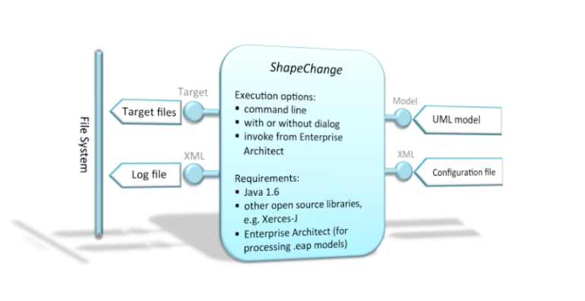
ShapeChange
ShapeChange v.3 now supports EA 16.x (2023-11-29)

Slide 13
Accessing and working with the HM
https://github.com/ISO-TC211/HMMG/wiki#accessing-the-isotc-211-harmonized-uml-model
HM cloud repository (read/write access, for editors)
Cloud based, latest versions of all approved changes for all models
Sparx ProCloud Web (open for anyone)
http://iso.sparxcloud.com/index.php
Sparx ProCloud Reusable Asset Service (RAS)
Read access - download published versions of individual model packages directly into any EA project
GitHub resources:
Standalone ‘Official’ EA project – periodically synchronized with ProCloud
Standalone ‘Editorial’ EA project – periodically synchronized with ‘Official’ EA project + ‘Editorial’ Packages
ProCloud is the primary repository
EA projects on GitHub are provided for convenience, and are used by several PTs

Slide 14
Other issues
Collaboration with OGC
OGC is setting up a ProCloud with a Harmonized OGC UML Model
Potential for good integration of models
Potential for exchanging experiences
Sparx follow-up
Joint meeting with OGC and Sparx on ProCloud issues
Specified several other issues that should bee discussed
Formalization of collaboration

Slide 15
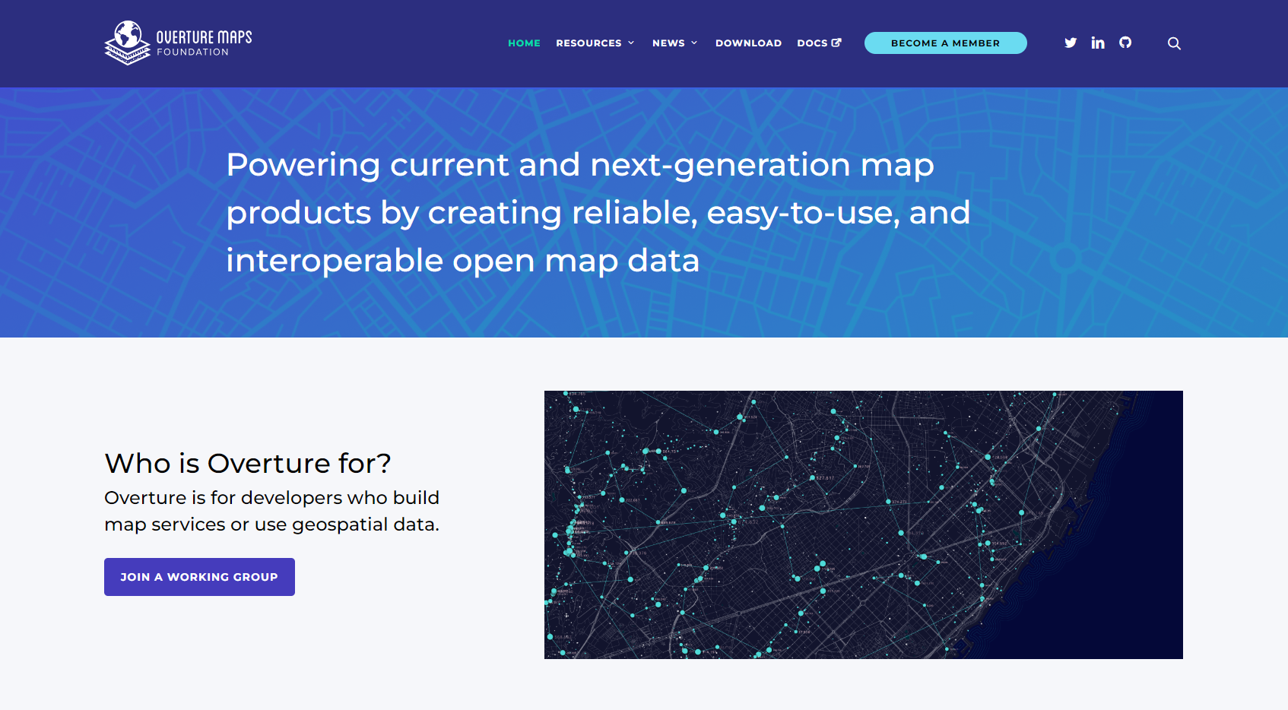
Overture Maps - https://overturemaps.org/
Who, What and Why we should care

Slide 16

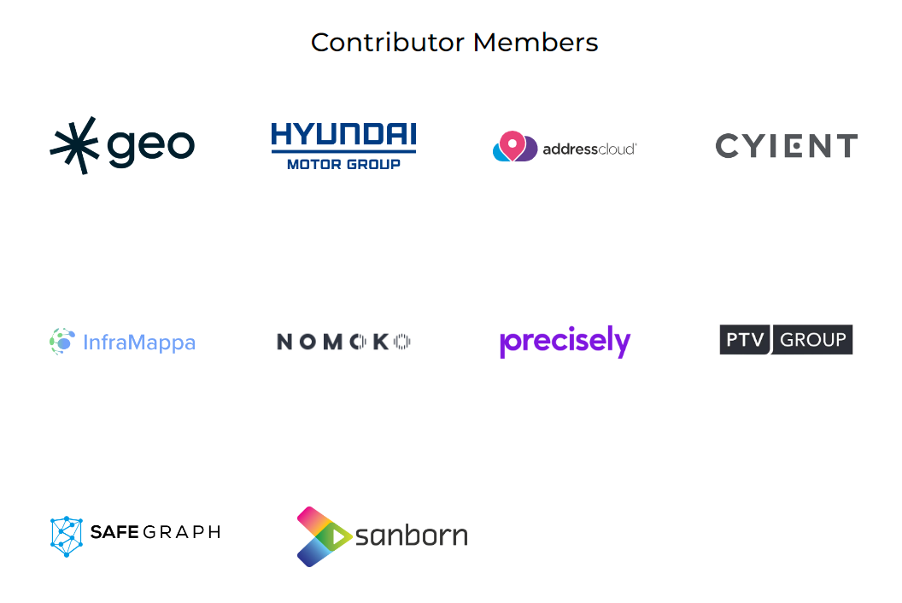
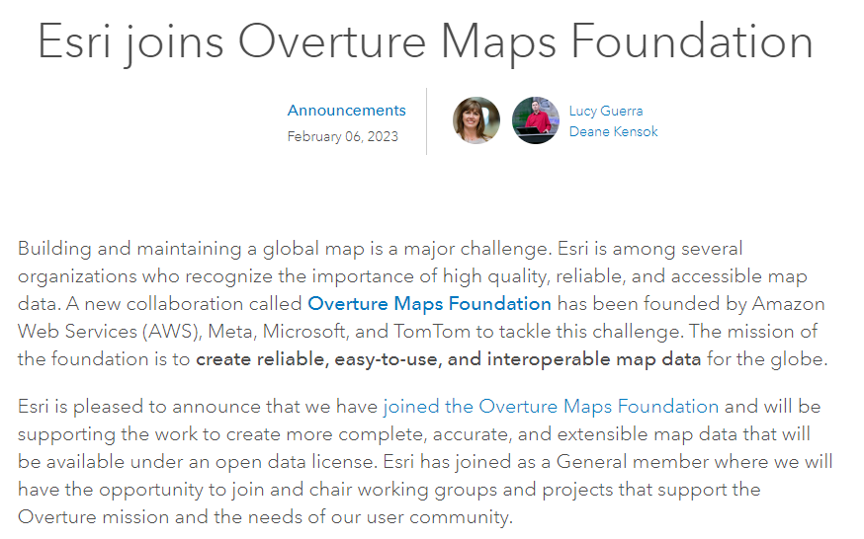
Who are Overture Maps?
Esri joins Overture Maps Foundation

Slide 17
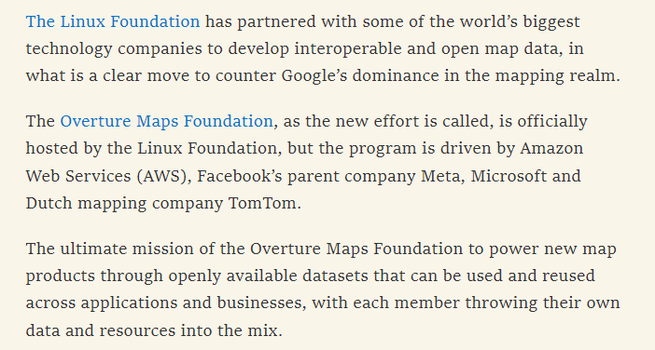
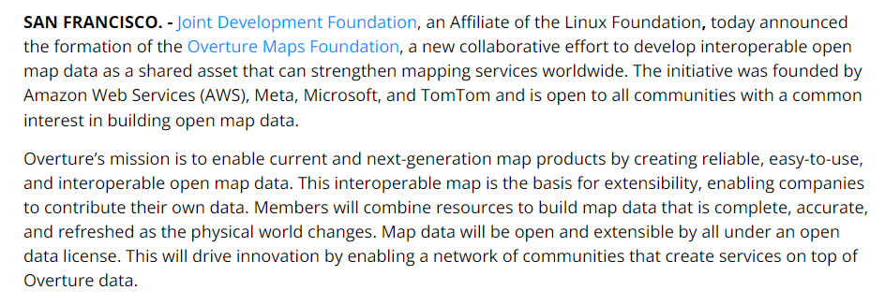
What is Overture Maps?
Meta, Microsoft, AWS and TomTom launch the Overture Maps Foundation to develop interoperable open map data | TechCrunch
Joint Development Foundation Announces Overture Maps Foundation to Build Interoperable Open Map Data (linuxfoundation.org)

Slide 18
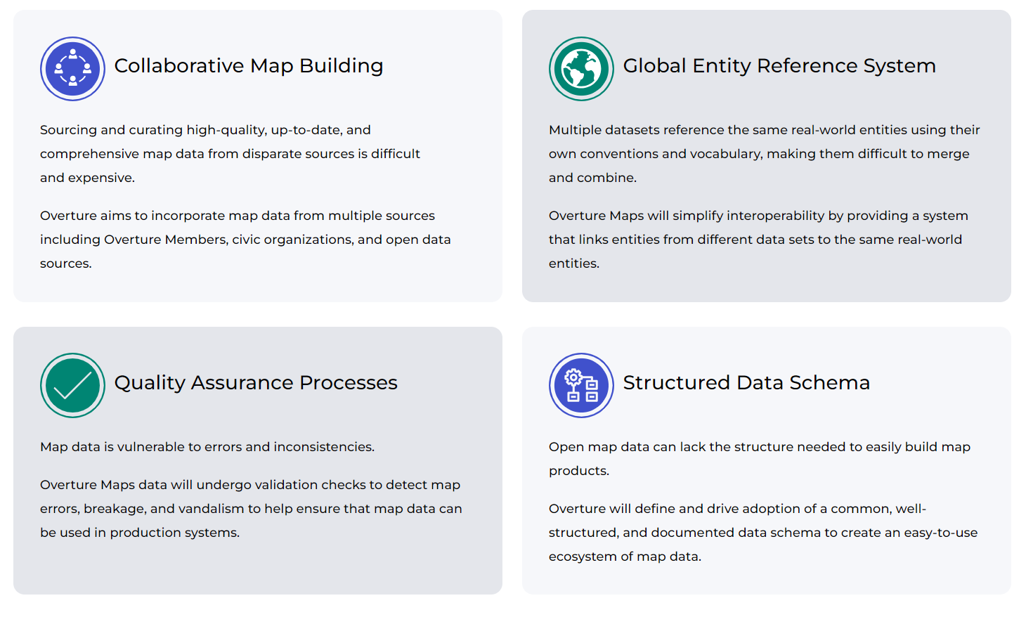
What is the scope of Overture Maps?

Slide 19
Why we should care
Run by extremely big companies
Don’t care about ISO standards?
May make ISO standards less relevant?
Different technologies
JSON and YAML Schemas
Parquet format
ASW and MS Synapse
Unique identifiers
Similar concepts
What we must do:
Observe the development
Consider the consequences
What we should do:
Invite Overture Maps as liaisson in ISO/TC 211
Are they interested?
May be more of an OGC task?
Core principles and abstract schemas concerns ISO/TC 211

Slide 20
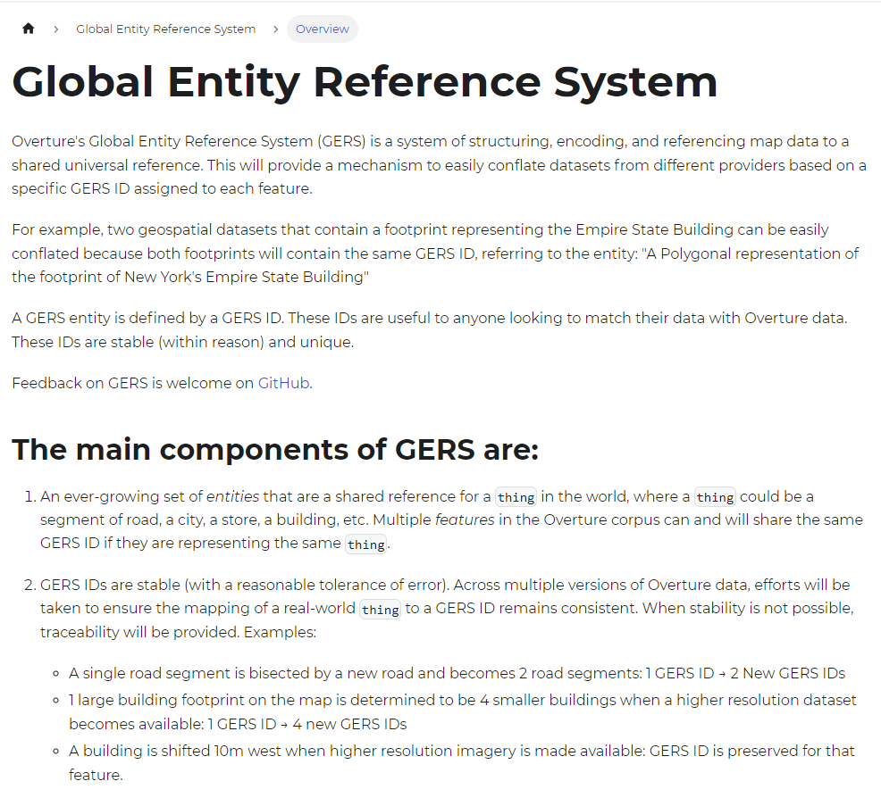
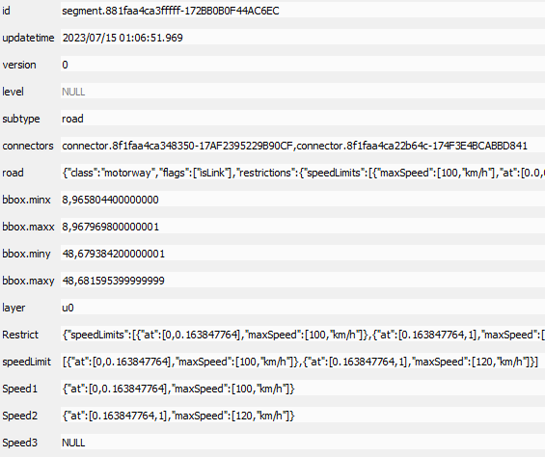
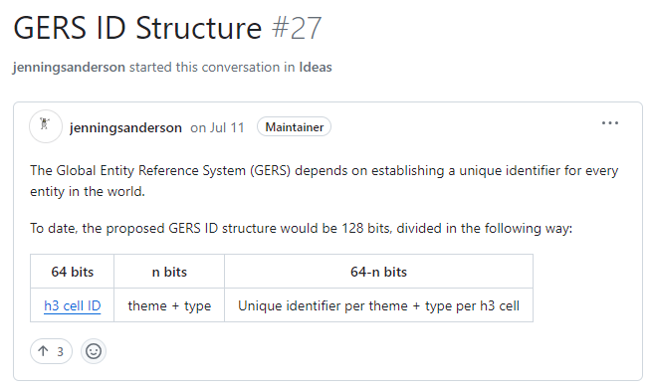
Unique identifiers - https://docs.overturemaps.org/gers/

Slide 21
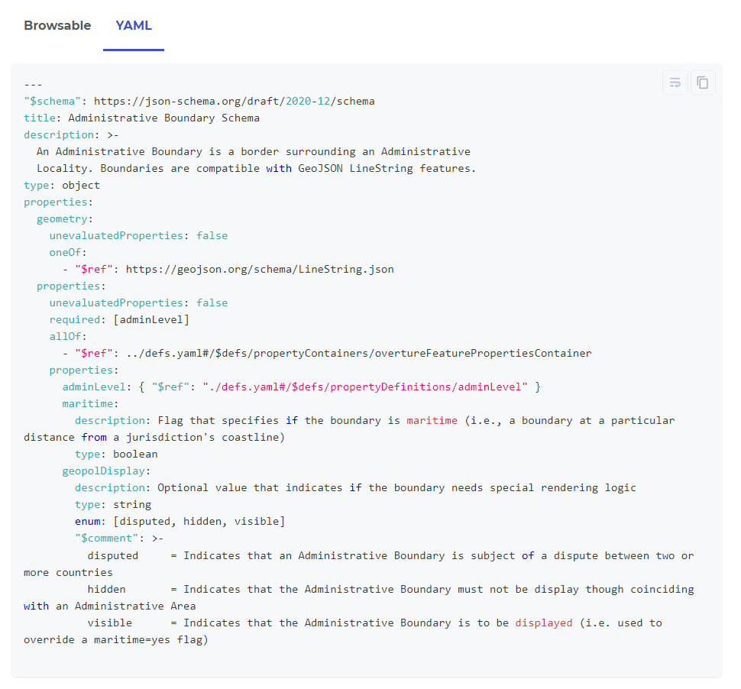
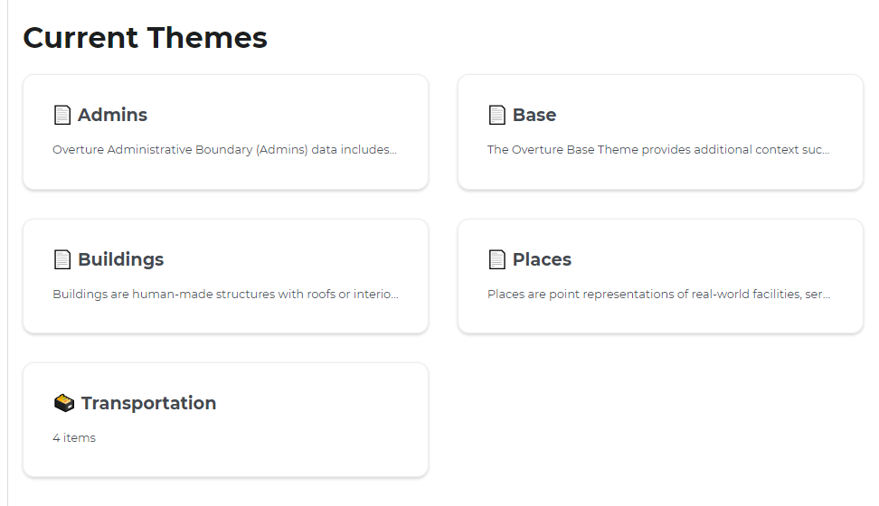
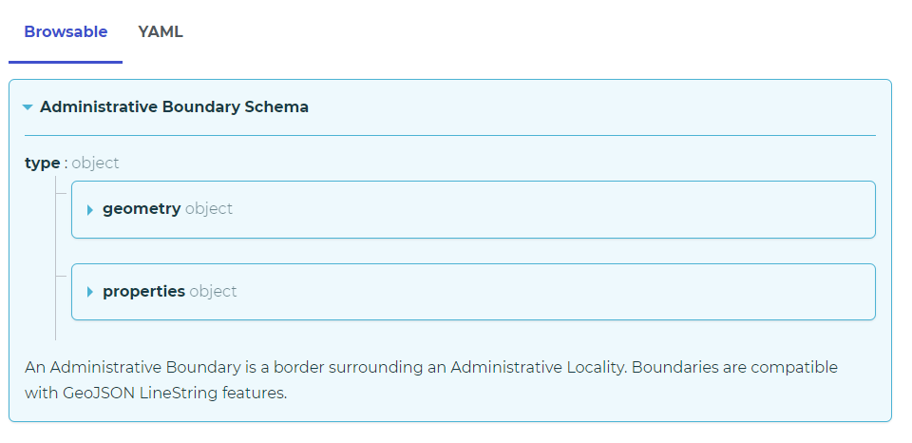
Data Schemas - https://docs.overturemaps.org/

Slide 22
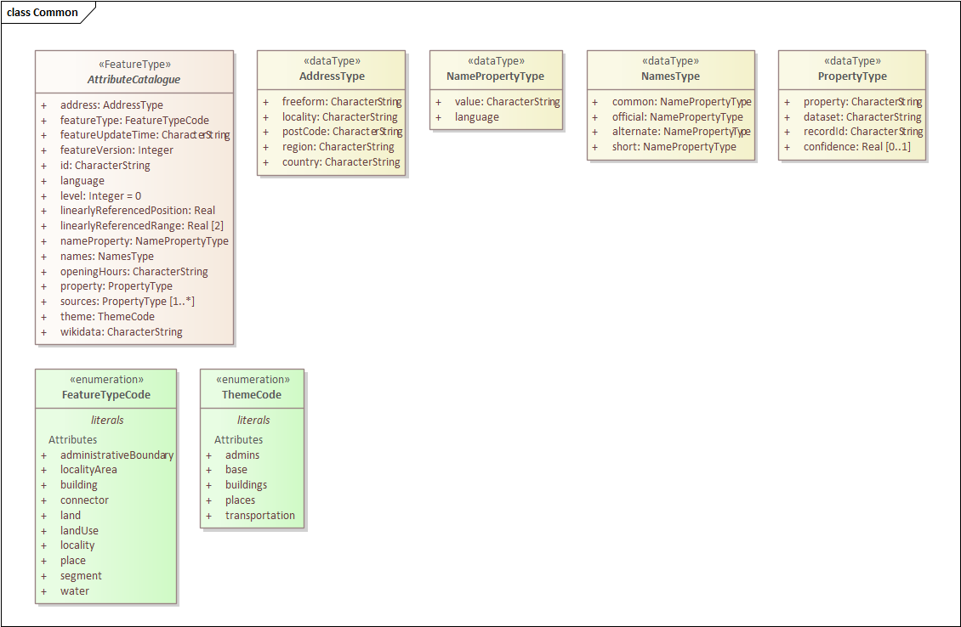
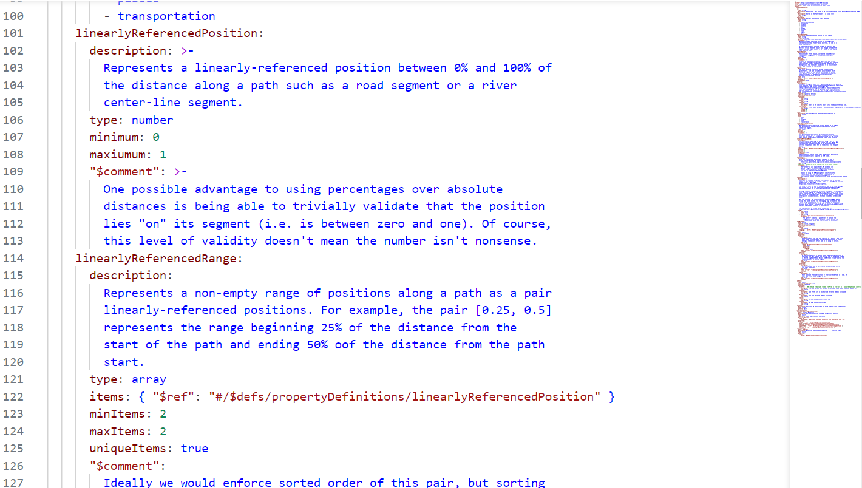
YAML and ISO/TC 211 UML

Slide 23
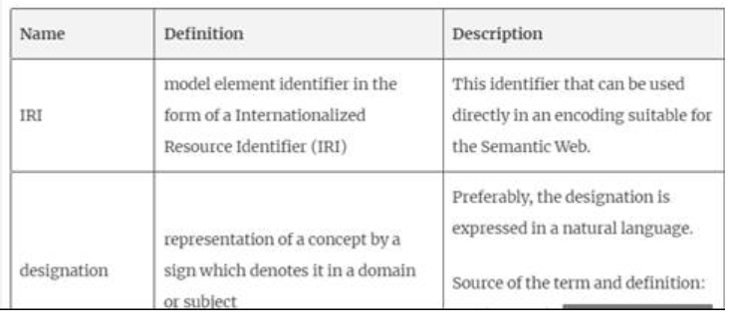
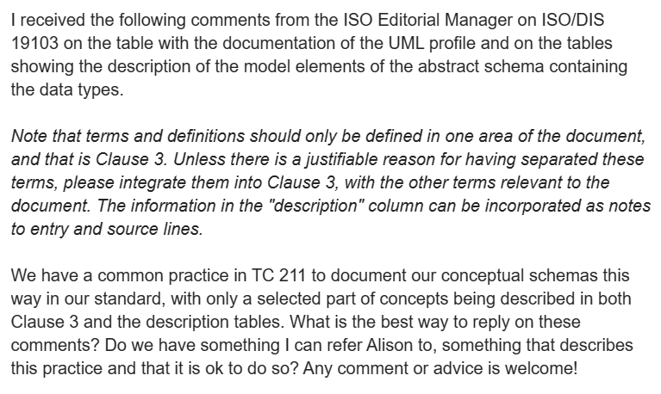
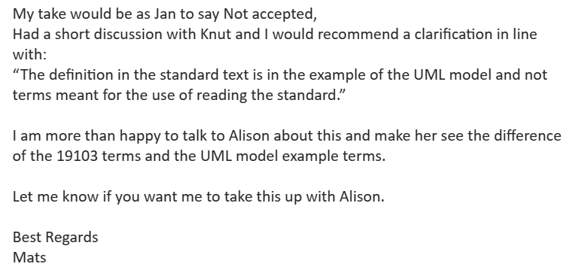
Other issues from projects
Definitions in the UML vs Clause 3
Comments from ISO CS for ISO/DIS 19103
Definitions in clause 3 are for understanding the standard

Slide 24
Other issues from projects

Slide 25
Liasion activity
Tried several points of contact with OMG
Mr Nisho’s address outdated
No address for Mr Watson
No response on liaison@omg.org
No response from Mr Bennet, Technical Director of OMG
Keep trying!

Slide 26
Suggested resolutions

Slide 27
HMMG Meeting Highlights
Status
Almost all project models in or on the way into the HM
Good cooperation with most PTs
Cooperation with OGC and Sparx
Integration of models
Exchange of experiences
Follow up with Sparx on some suggested improvements
HMMG Attendance
Project leaders, editors and WG convenors must register as HMMG Members and are expected to attend the HMMG meeting
EA is mandatory for all UML work!
Use a recent version (15 or 16)
ShapeChange supports both versions
Sparx Systems provides free licenses for development and maintenance of the Harmonised Model
Experts, Project leaders, Editors, Convenors…
Requests are handled through the ISO/TC 211 Secretariat

Slide 28

HMMG Meeting Highlights
Overture Maps
Big companies, open data – will be important for the future
Open schemas in YAML
HMMG working on scripts for mapping to ISO/TC 211 UML
Unique identifiers
Linear referencing
ISO/TC 211 need to:
Observe the development
Consider the consequences

Slide 29
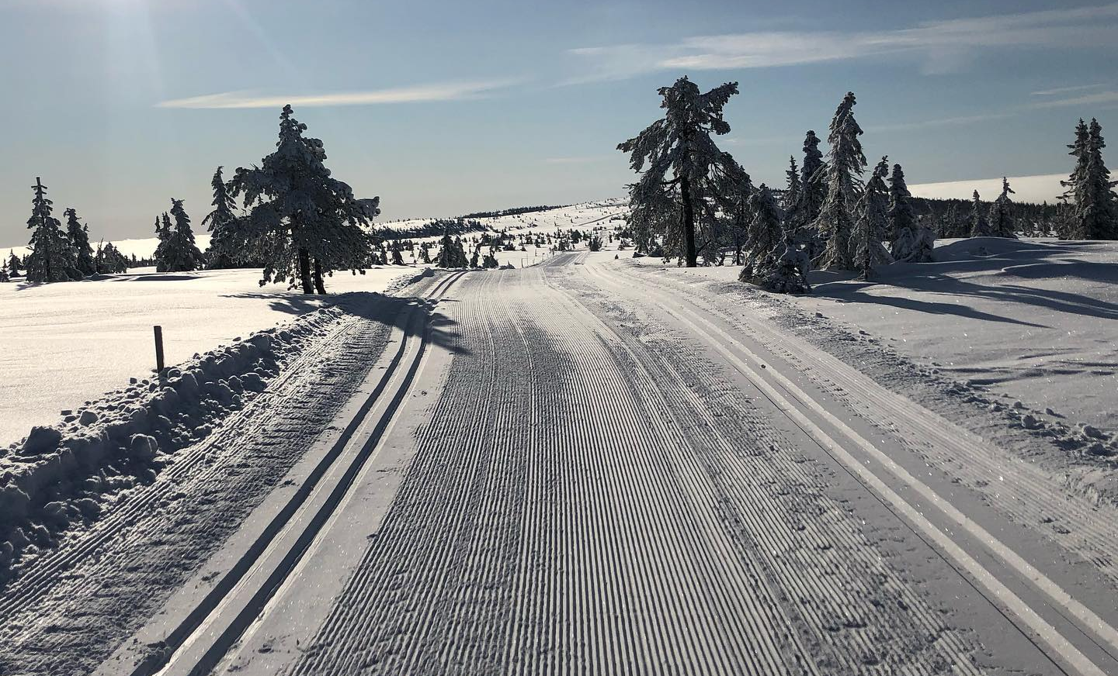
Any other business?

